Slide 1

Prof. Dr. Andreas Brandner
Webinar, 5 September 2023
Knowledge for Development
Leveraging Knowledge Management (KM) to support the implementation of the Global Biodiversity Framework’s (GBF) Goals and Targets and the Sustainable Development Goals (SDG)

Slide 2
Content
Knowledge is at the heart of sustainable development
KM for Biodiversity Initiative and Challenge 2023
Implementation timetable
National Knowledge Management Strategies

Slide 3
Knowledge is at the heart of sustainable development
Overview

Slide 4


Knowledge for Development
Knowledge is an essential resource and an
indispensable prerequisite for the development of societies all over the world.
SDG17 calls for partnerships for knowledge sharing and collaboration. KM is a key enabler.
The Knowledge for Development Partnership is an international multi-stakeholder partnership to advance knowledge for development. It connects more than 2000 partners including senior KM experts from all SDG areas incl. water and sanitation, agriculture, biodiversity, and many more

Slide 5
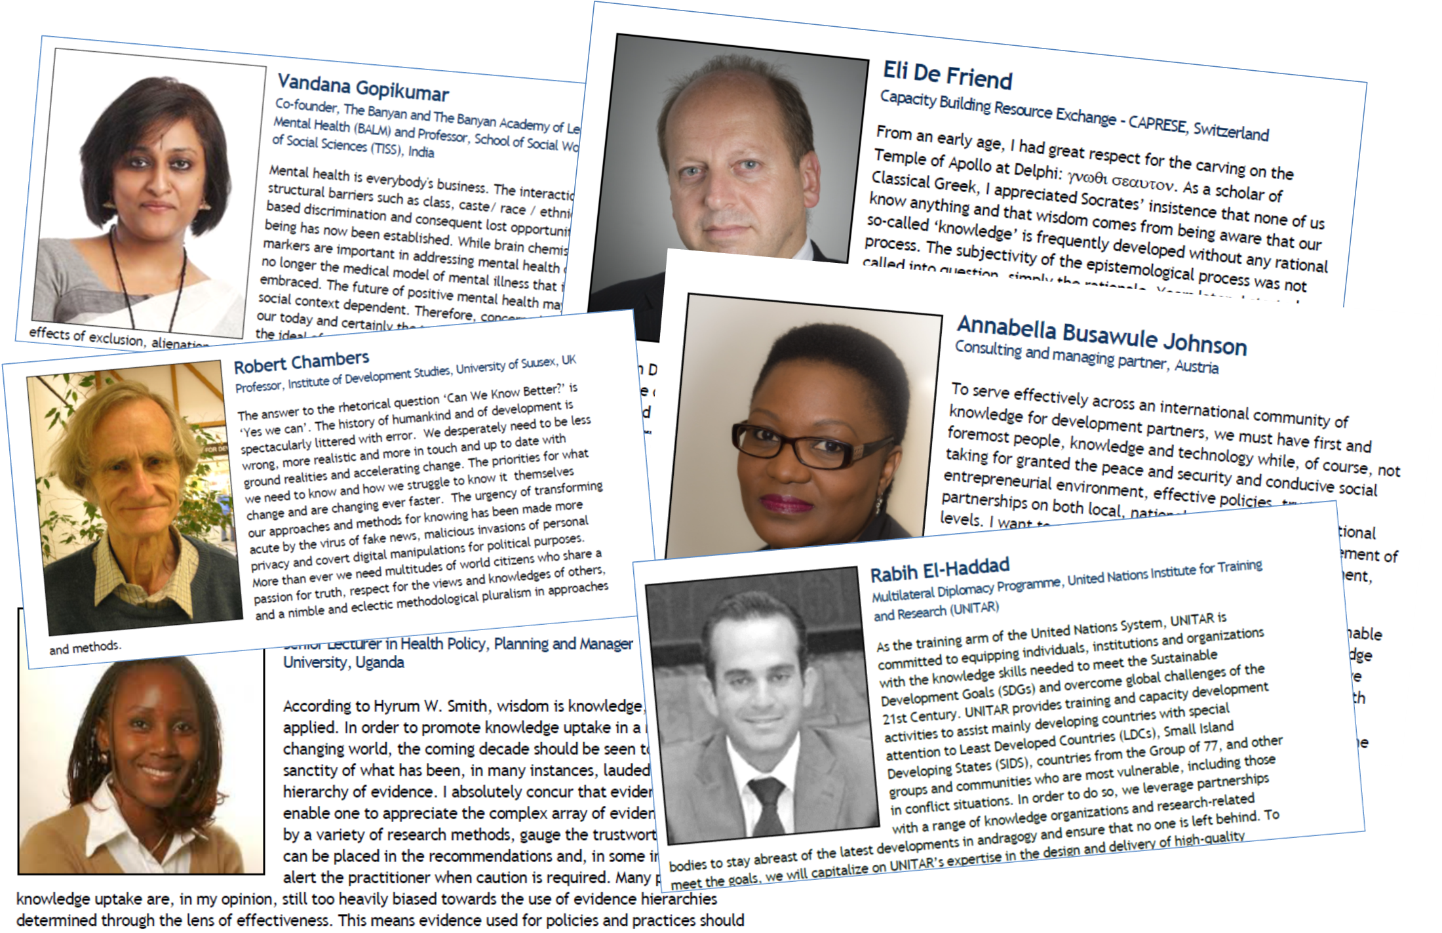

Slide 6
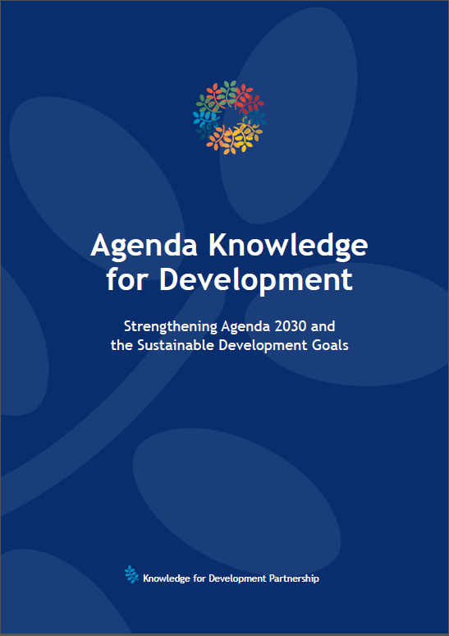
The Agenda Knowledge for Development see www.k4dp.org/agenda
The KDGs are a key element and based on the statements of the 150+ authors.
E Goal 1: Pluralistic, diverse and inclusive knowledge societies
E Goal 2: People-focused knowledge societies
E Goal 3: Strengthening local knowledge ecosystems
E Goal 4: Knowledge partnerships
E Goal 5: Knowledge cities and rural-urban linkages
E Goal 6: Advanced knowledge strategies in public and development organisations
E Goal 7: Capture, preservation and democratisation of knowledge
E Goal 8: Fair and dynamic knowledge markets
E Goal 9: Safety, security, sustainability
E Goal 10: Legal knowledge
E Goal 11: Improved knowledge management competences
E Goal 12: Institutions of higher education to play an active role
E Goal 13: Information and communication technologies for all
E Goal 14: The arts and culture are central to knowledge societies

Slide 7
Activities of K4DP
-> www.k4dp.org
Supporting countries to develop a National Knowledge Agenda
Facilitating national and sectoral Knowledge Partnerships and Challenges
Advancing Knowledge Management in public and private organisations
Fighting knowledge divide
Helping to build powerful knowledge hubs in sectors
Providing evidence on knowledge ecosystem
Strengthening knowledge dissemination and communication
Strengthening academic education and research in Knowledge Management
Fostering international cooperation for investment in knowledge

Slide 8
Knowledge is scattered across stakeholders and sectors
Government and
Public Agencies
Education and
Science
NGOs,
Dev Partners
KM
KM
KM
Biodiversity
knowledge
platforms
Business
sector
KM
Water,
Energy, other
sectors
Etc. etc. etc.
KM
KM
KM

Slide 9
Let´s join forces...
Government and
Public Agencies
Education,
Science, Culture
NGOs,
Dev Partners
KM
KM
KM
Biodiversity
knowledge
platforms
Business
sector
KM
KM
KM
KM
Water,
Energy, other
sectors
Etc. etc. etc.

Slide 10
… to create an Biodiversity
Knowledge Agenda!
Education,
Science, Culture
Government and
Public Agencies
NGOs,
Dev Partners
Biodiversity
Knowledge Agenda
Biodiversity
knowledge
platforms
Business
sector
Water,
Energy, other
sectors
Etc. etc. etc.

Slide 11
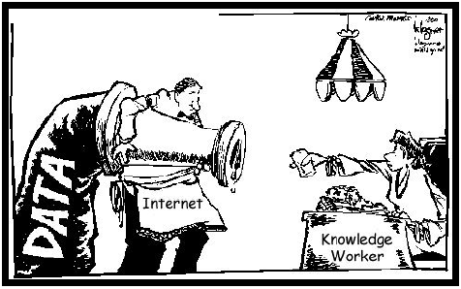
Data/information is not knowledge

Slide 12
One definition of knowledge
Knowledge is the living body of all experiences, learnings, information, and other knowledge resources that are consciously and unconsciously bundled in daily life to create one´s future.
As such, knowledge is a living process built on knowledge resources, but also on the capacity of bundling these knowledge resources to take action for a better future.

Slide 13
Implicit/Tacit vs Explicit Knowledge
Implicit/tacit Knowledge
subjective, personal
experience
valid only here and now
related to specific context
practise
Explicit Knowledge
objective
rational
generic
does not depend on a context
theory
Implicit/Tacit Knowledge
Explicit Knowledge

Slide 14
Three categories of knowledge
Knowledge is ..
Human knowledge
leaving the organization every evening
Codified knowledge
remaining in the company when people leave
External knowledge
staying outside but being relevant to operations

Slide 15
What can you see?

Slide 16
What can you see?

Slide 17
What can you see?

Slide 18
The steps to competitiveness
Competitive
ness
Strategic KM
Competence
+ Uniquness
Action
+ Added value
Ability
+ Motivation
Knowledge
+ Skills
Information
+ Relation to
experience
Data
+ Meaning
Symbols
+ Syntax
Operatational KM
Source: Klaus North, Wissensorientierte Unternehmensführung, 2002

Slide 19
Knowledge Management:
Our definition
Knowledge Management is
a targeted, integrated, and systematic approach
to identifying, acquiring, creating, sharing, applying, and capturing knowledge,
relevant to achieving the specific objectives of the organization.
Notes:
Story notes: We see progress on the development of output level indicators (outreach/communications, resources and tools, policies, and training), however there seems to be a gap in the implementation of these (incl. the implementation of policies) leading to tangible and concrete changes in practices as evident by the limited reporting on outcome level indicators.
The first 5 years of 10YFP: establishing the network, building the knowledge base, awareness raising, developing and gathering the resources and tools of the network, providing capacity development
The next 5 years of 10YFP: using the network, resources/tools, awareness raising and trainings to effectively support governments and organisations in implementing and integrating concrete changes in practices, resulting in net positive impacts

Slide 20
Targeted, systematic, integrated Knowledge Mangement
Knowledge goals
Knowledge assessment
Finding knowledge
Capturing knowledge
Acquiring knowledge
Organising and linking knowledge
Applying knowledge
Creating knowledge
Sharing knowledge
Based on Probst, Raub, Romhardt, Managing Knowledge, 1999

Slide 21
Strategic, targeted, integrated approach to KM:
Biodiversity KM Framework
Knowledge Leadership and Governance
Finding
Acquiring
Human Assets
Skills, experiences,..
Knowledge Services
Researching, training advising, convening, facilitating, catalysing, communicating, etc.
Products
Publications, extension resources, technology and innovation pratices, policy briefs, articles, videos, etc.
Organisational
Development
Creating
Sharing
Structural Assets
open data, knowledge hubs,..
Biodiversity
Development
Using
Capturing
Relational Assets
Networks, Communities of Practice,..
SDGs - Global
Development
KNOWLEDGE
LIFECYCLE
KNOWLEDGE
ASSETS
PROCESSES
SUSTAINABLE
DEVELOPMENT
Monitoring and Learning

Slide 22
Knowledge Management for Biodiversity Challenge 2023+
Overview

Slide 23
Levels of responsibilities
4. Knowledge-based Development
(sectoral, national, global level)
3. Knowledge Management
(organisational level)
2. Knowledge Work
(individual level)
Knowledge Ecosystems require responsible action on all societal levels with managed linkages between the levels.
1. Knowledge Theory
(academic level)

Slide 24
KM4B Challenge:
The motivation
Knowledge needs to be managed professionally across organisations to create vital and performative knowledge ecosystems.
Qualified Knowledge Managers are needed in all sectors and at all levels, and they profit from joint learning and experience sharing.
Due to the complexity and distribution of knowledge in the biodiversity they need to master the KM Challenges together.
Solutions shall be developed and implemented in partnership based on an integrated KM approach.
The KM Challenge has been successfully implemented in the agricultural sector in cooperation with FARA and all relevant continental partners in 2021 and 2022 – KM4AgD Challenge. See a here: video

Slide 25
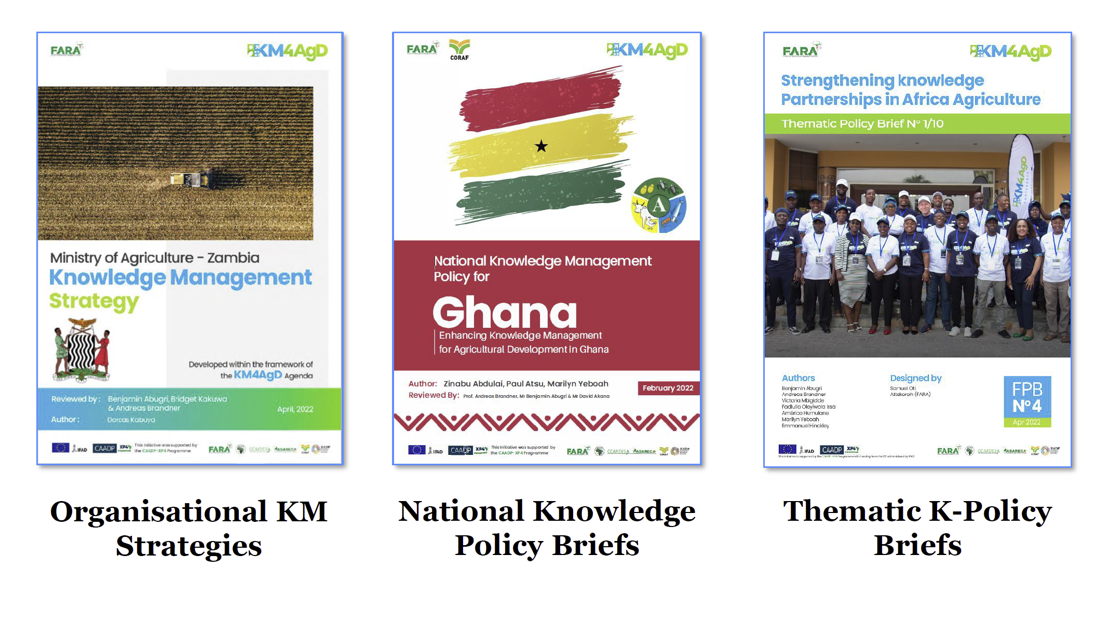
Sample outputs of the
KM4AgD Challenge 2021/2022

Slide 26
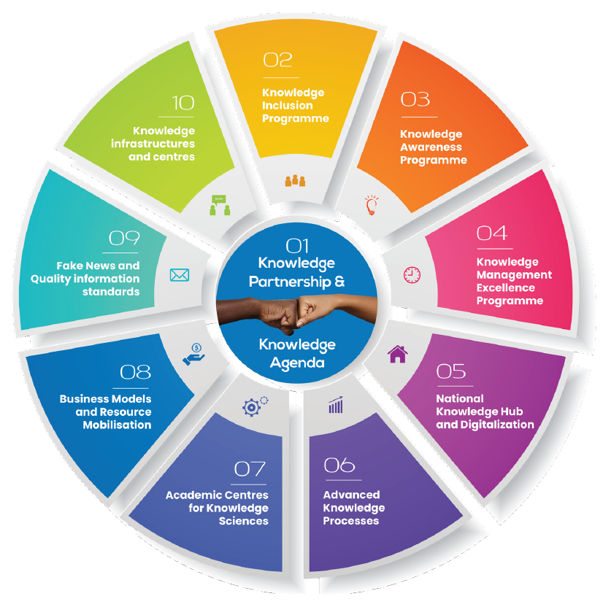
Knowledge Agenda for Agricultural Development – a great reference for Biodiversity

Slide 27
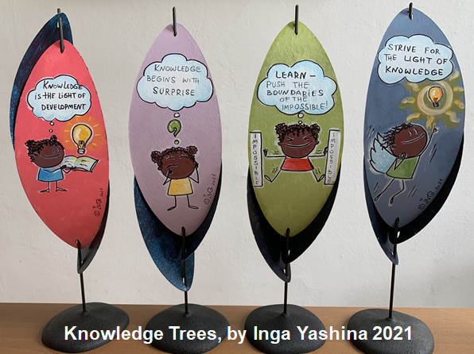
Art is part of the programme fostering wisdom

Slide 28
KM4B Challenge 2023+
A joint programme of the CBD and the Knowledge for Development Partnership
National focal points of all CBD Parties to join the KM4B Challenge 2023
Faculty with 20+ TOP KM experts with specialisations in Biodiversity
20 training sessions of 1,5 hours and online learning material on organisational and sectoral Knowledge Management with strong interaction and peer collaboration.
Participants are guided to
  develop their own organisational Knowledge Management Strategies
  co-create sectoral/national Knowledge Policy Briefs
  jointly develop the Biodiversity Knowledge Agenda
Participants shall be awarded “Certified Knowledge Managers for Sustainable Development”
Solutions and findings are presented at regional conferences
Biodiversity KM CoP launched

Slide 29
National
Knowledge Management
Overview

Slide 30
Agenda Knowledge for Uganda
Happy
knowledgeable citizens
Knowledge-driven
collaborative
organizations
Sustainable
knowledge
society
Diversity and pluralism
Quality education for all, key knowledge skills
Empowered youth and generation partnership
Knowledge inclusion
Knowledge communication
Access to ICT
Knowledge work and entrepreneurship
Knowledge-service providers public/private
Knowledge, learning, innovation Management
Digitalization
Knowledge acquisition
Investment in knowledge services and technology
Knowledge export and knowledge tourism
Stronger linkage of companies with schools and academic institutions
Ugandan knowledge identity and heritage
K-strategies and k-partnerships in sectors
Diaspora knowledge and knowledge of immigrants
International knowledge networks and leadership
Open knowledge, smart public services
K-cites and k-spaces
Religion, art, and culture
*

Slide 31
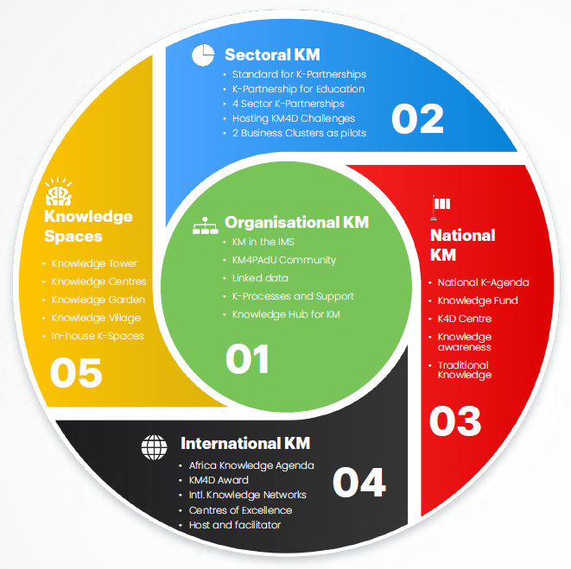
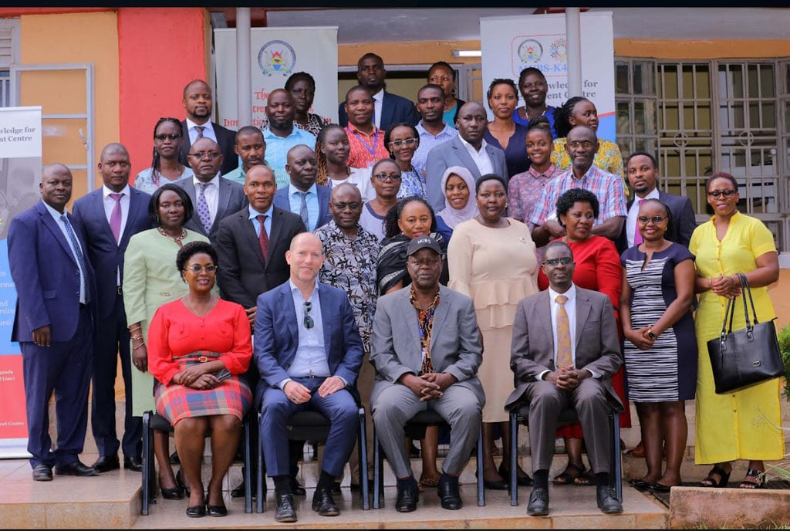
KM4PADU: KM for the Public Administration of Uganda
*

Slide 32


Agenda Knowledge Process
Projects
and
thematic
workshops
Council
Development/Review
of the Knowledge Agenda
Council
Projects
and
thematic
workshops
Conference
Agenda
Knowledge
Projects and
thematic workshops
Knowledge
Agenda
Round Table
Facilitation by a professional facilitator
January - March
March
April - September
September
October-December

Slide 33
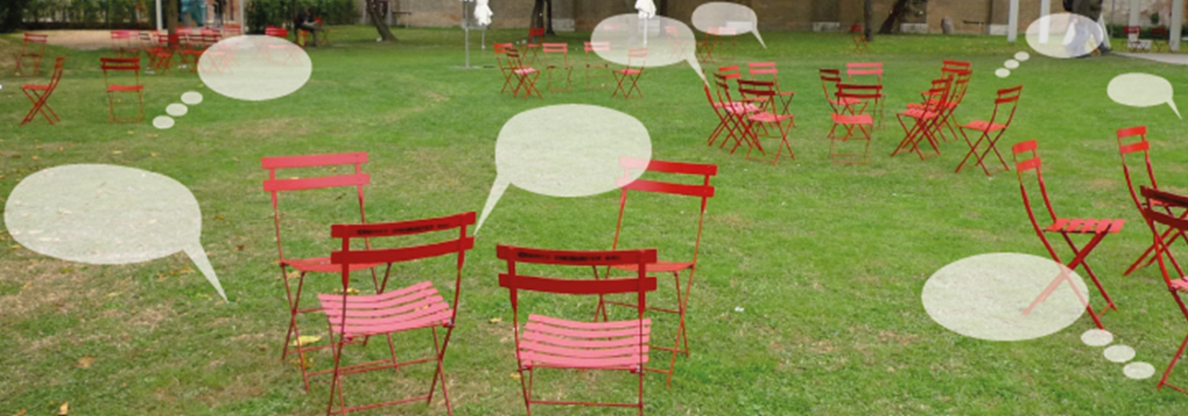
Q&A - discussion

Slide 34
Contact
Prof. Dr. Andreas Brandner, Executive Director
Knowledge for Development Partnership
Email: andreas.brandner@k4dp.org
www.k4dp.org

Slide 35
My background
Executive Director, Knowledge for Development Partnership (www.k4dp.org)
Core team member, km4dev Community (km4dev.org)
Managing Director, Knowledge Management Austria
Adj. Professor, Makerere University Business School in Kampala, Uganda
Director, Joint Centre for Knowledge Sciences, International University of Management, Namibia
KM Advisor, ADB
Scientific Lead, Knowledge Management for Development Challenges
Headquartered in Vienna/Austria, acting globally

