Slide 1
MADRESA HIGHSCHOOL-ANAND
GUJCOST SCIENCE CLUB

Slide 2

INTERNATIONAL
BIODIVERSITY YEAR 2010
CELEBERATED BY:-
MADRESA HIGHSCHOOL-ANAND0

Slide 3
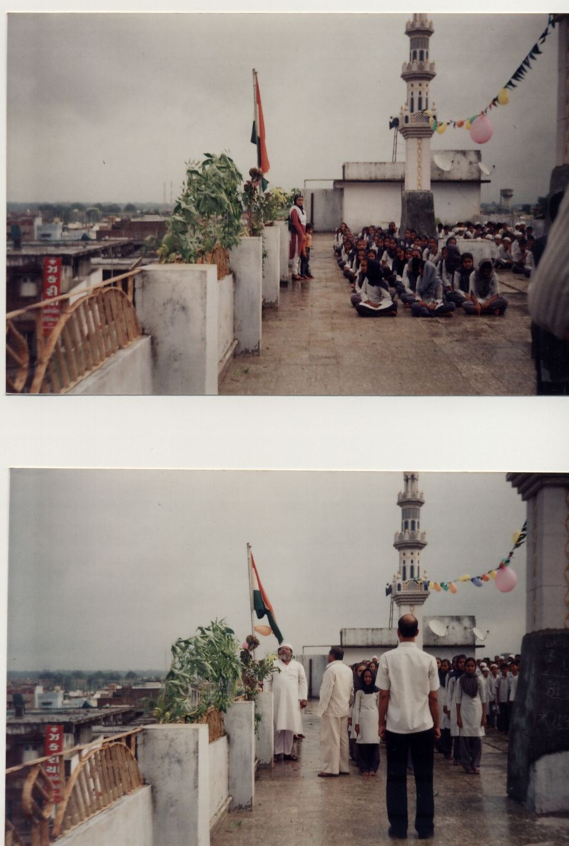
15th AUGUST
NATIONAL INDEPANDENCE DAY

Slide 4

64TH NATIONAL INDEPENDENCE DAY

Slide 5
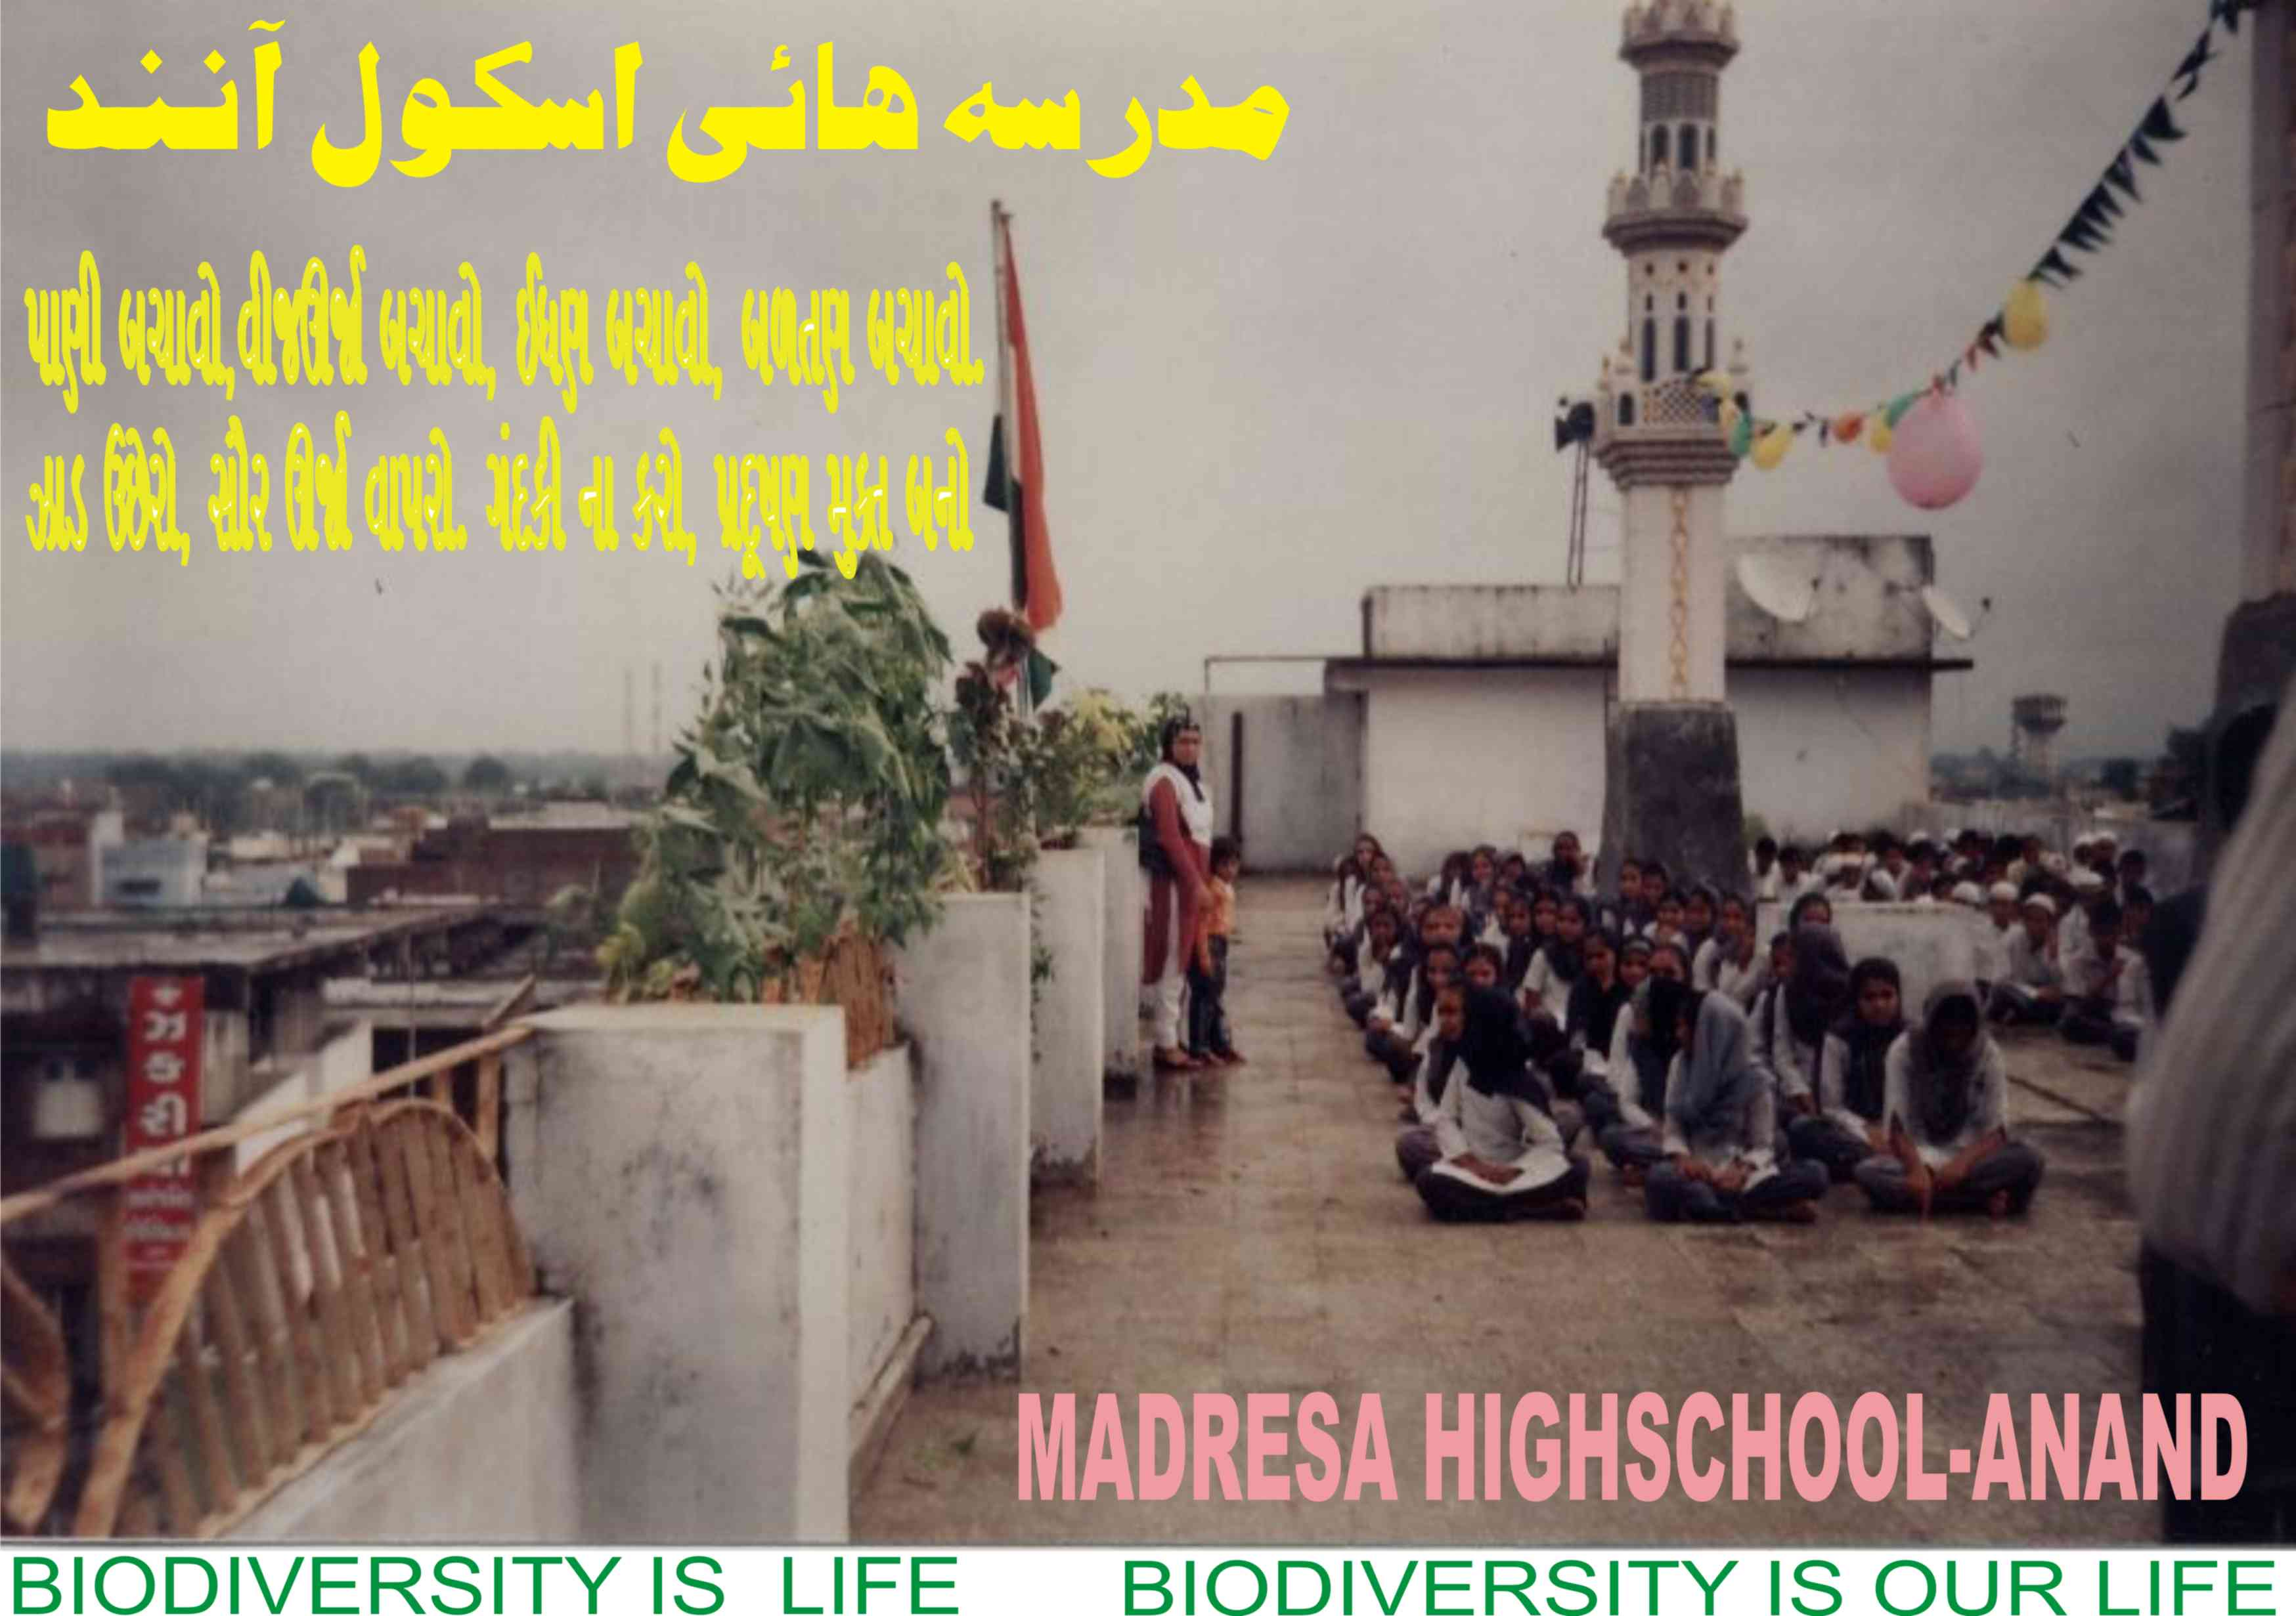

Slide 6


Slide 7
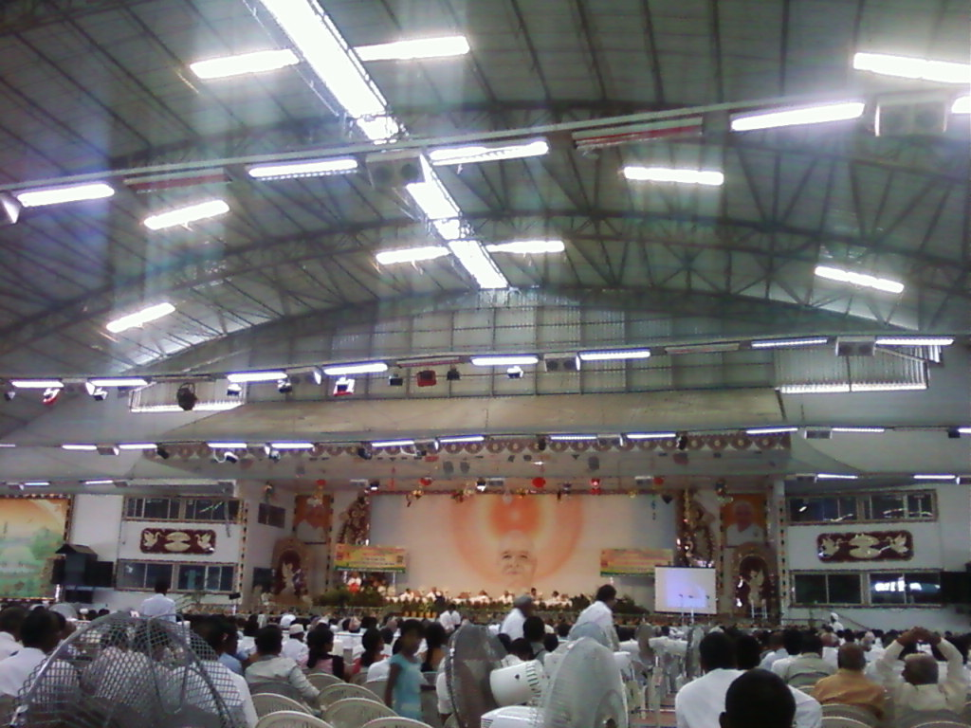
OUR SCIENCE CLUB CONVENOR Mr. M. M. SHEKH ATTENDS A SEMINAR OF “CLEAN THE MIND, GREEN THE EARTH” B.K. ISHWARIYA VISHVAVIDYALAYA ARRANGED THIS SEMINAR. AT SHANTIVAN, ABU (RAJASTHAN).
HERE SOME PHOTOES RELATED TO BIODIVERSITY. THERE WAS MANY PLANTS ON STAGE AGAINST THE SPEAKERS AND AUDIENCE SO SCENARIO WAS VERY BUTIFUL AS GIVEN BELOW.

Slide 8
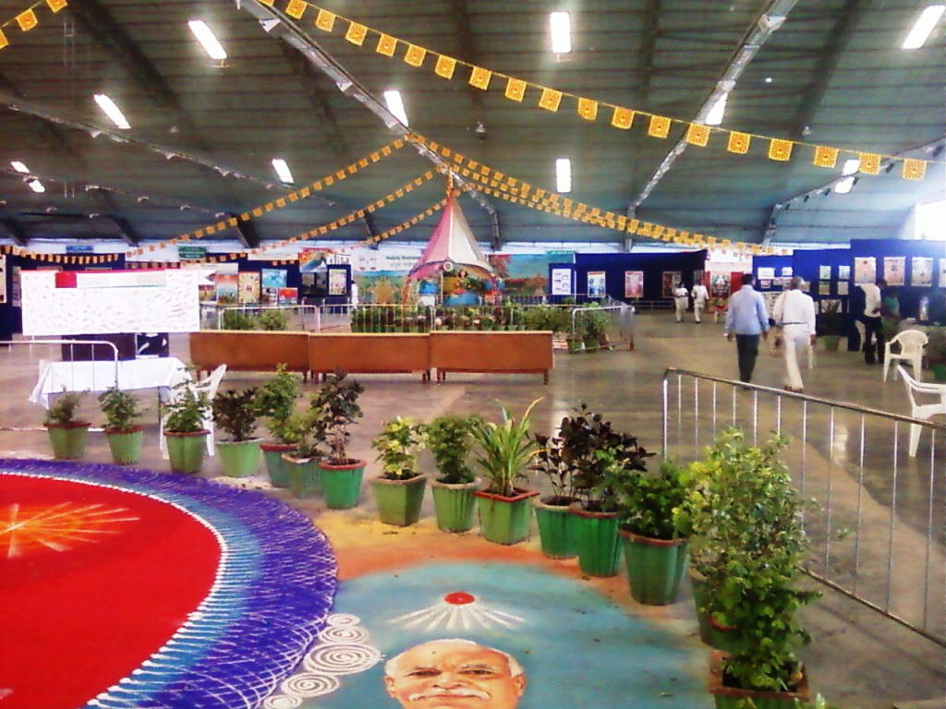
SHANTIVAN, ABU (RAJASTHAN).

Slide 9
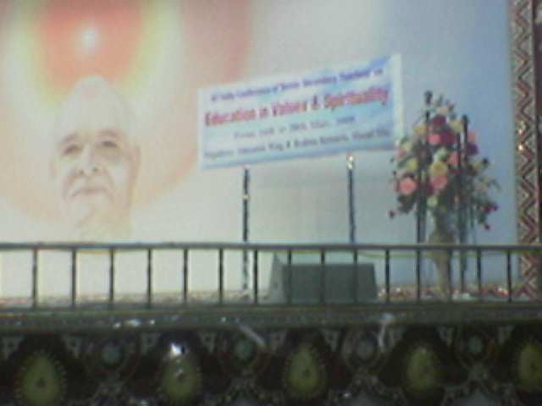
SHANTIVAN, ABU (RAJASTHAN).

Slide 10
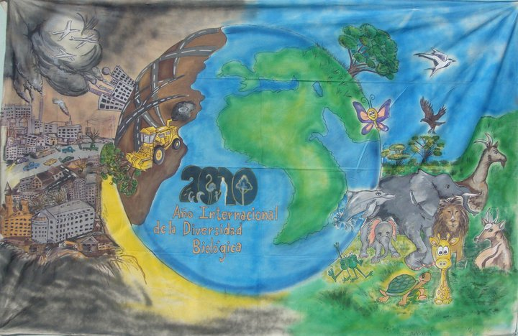

Slide 11
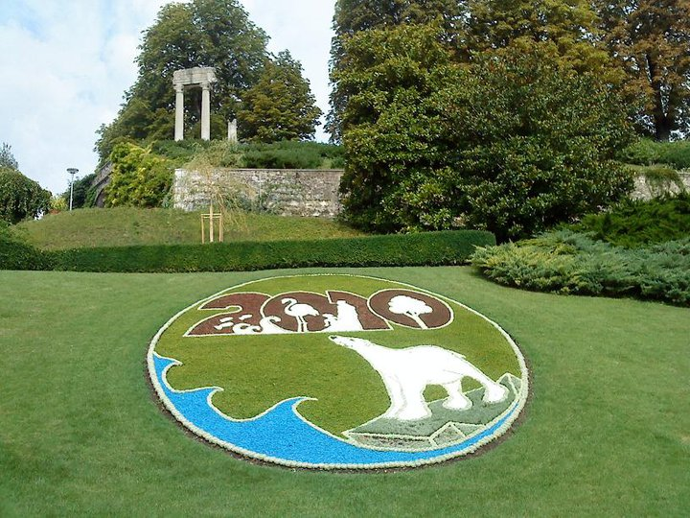

Slide 12
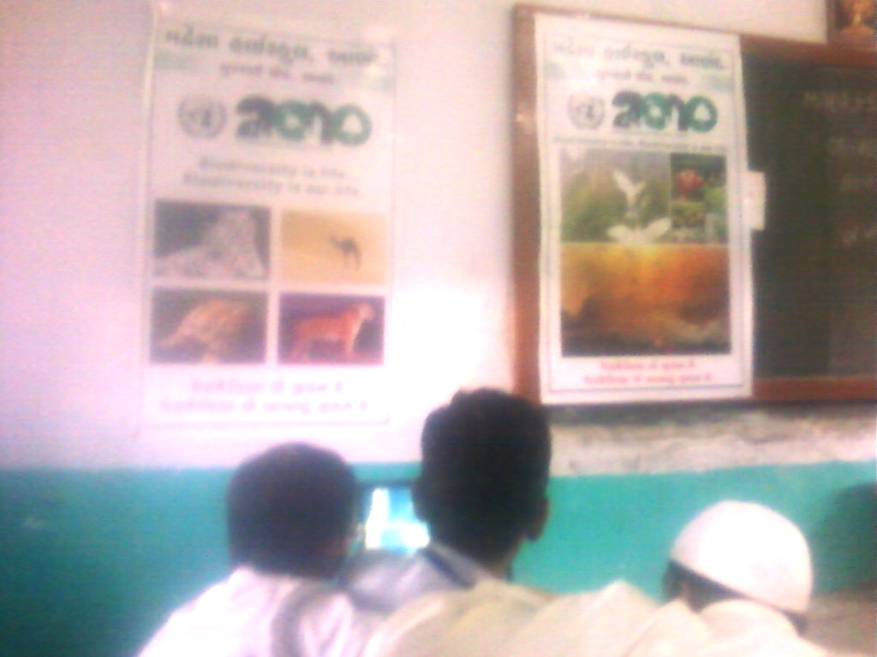
Participates in science fair organized by G.C.E.R.T. GANDHINAGAR
With the banner of International Biodiversity year 2010
And we get first prize

Slide 13
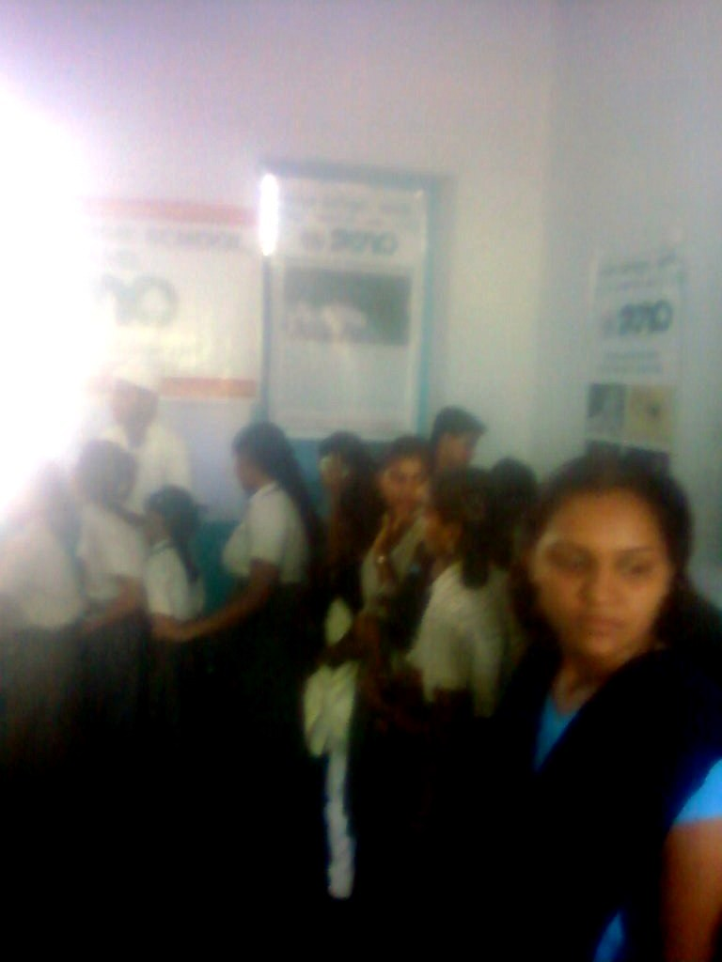
MADRESA HIGHSCHOOL-ANAND
Participates in science fair organized
by G.C.E.R.T. GANDHINAGAR
With the banner of International Biodiversity year 2010
And we get first prize

Slide 14
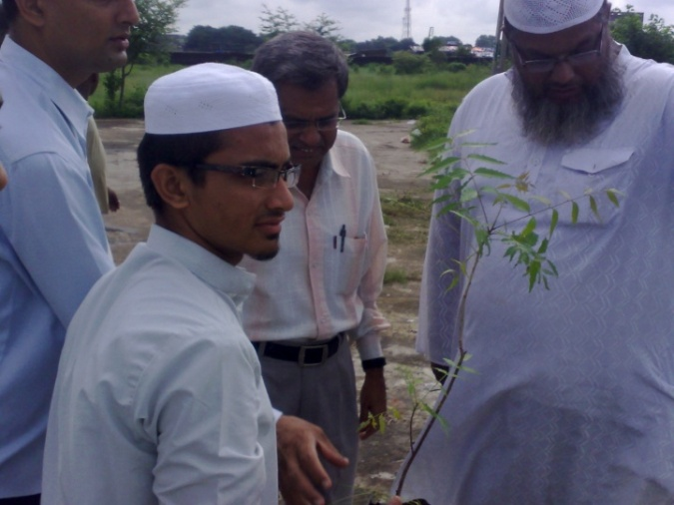
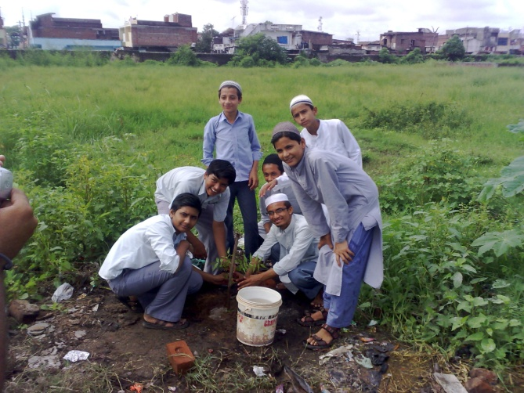
Madresa high school-ANAND
celebrates
6th September vu9arop` idvs = Growing Trees day

Slide 15
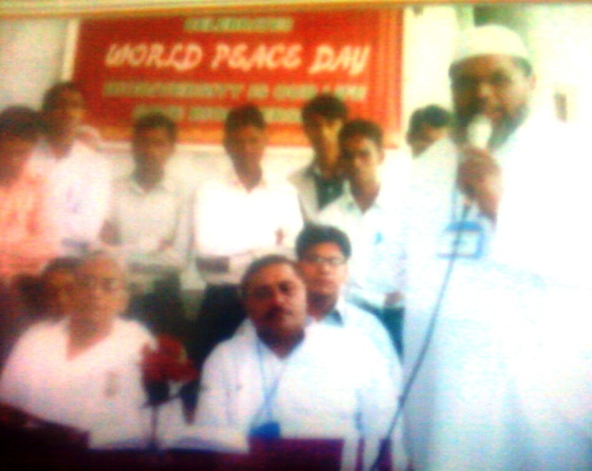
BRAHMAKUMARI ISHWARIYA VISWA VIDYALAYA’S GEETABEN WAS THE CHIEF GUEST
Convener M. M. SHEKH
EXPLAINED HOW
THE BIODIVERSITY
HELPS IN PEACE.
GEETABEN
PRINCIPAL

Slide 16
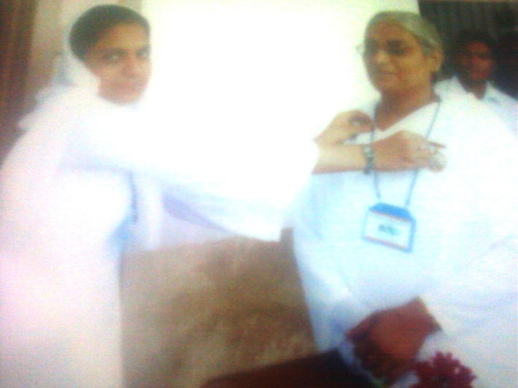
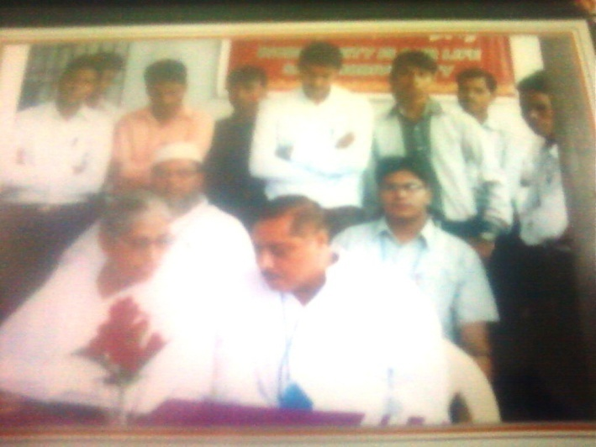

Slide 17
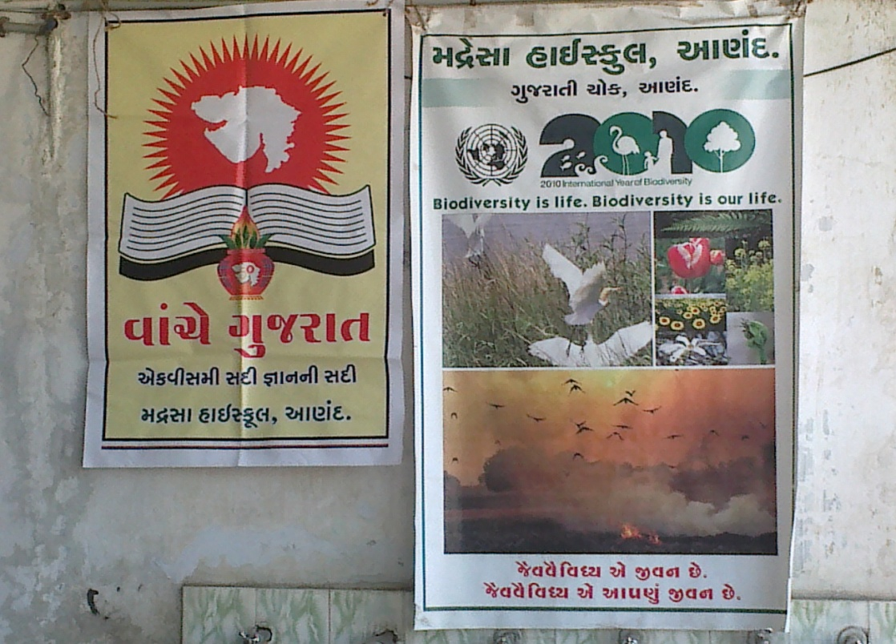
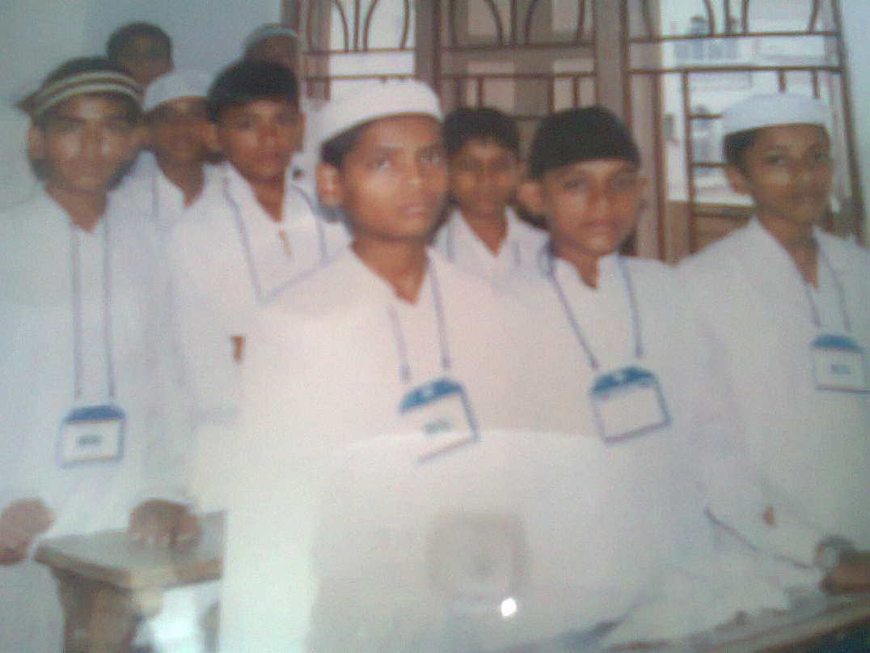
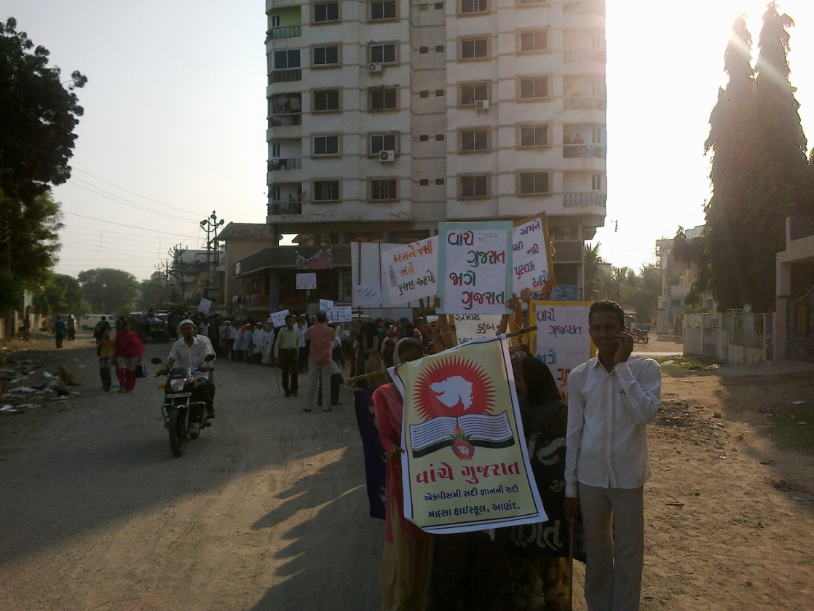
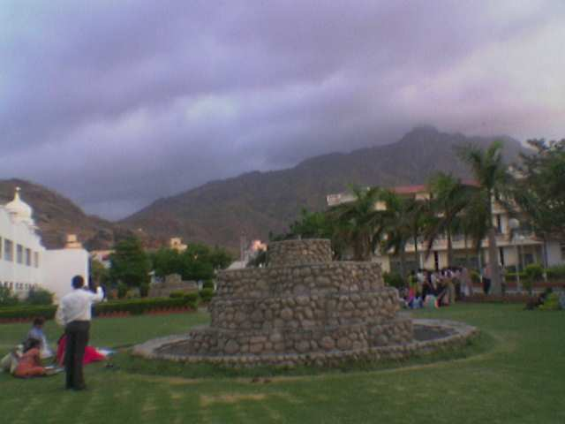

Slide 18
ACTIVITIES OF OUR SCIENCE CLUB
ALSO PUBLISHED ON
www.cbd.int/2010/country/?country=in

